Slide 1


Chapter 5
Divide and Conquer
Slides by Kevin Wayne.
Copyright © 2005 Pearson-Addison Wesley.
All rights reserved.

Slide 2
5.6 Convolution and FFT

Slide 3
Fast Fourier Transform: Applications
Applications.
  Optics, acoustics, quantum physics, telecommunications, control systems, signal processing, speech recognition, data compression, image processing.
  DVD, JPEG, MP3, MRI, CAT scan.
  Numerical solutions to Poisson's equation.
The FFT is one of the truly great computational developments of this [20th] century. It has changed the face of science and engineering so much that it is not an exaggeration to say that life as we know it would be very different without the FFT. -Charles van Loan
Notes:
Significance. Perhaps single algorithmic discovery that has had the greatest practical impact in history. Progress in these areas limited by lack of fast algorithms.
Variants of FFT used for JPEG, e.g., fast sine/cosine transforms

Slide 4

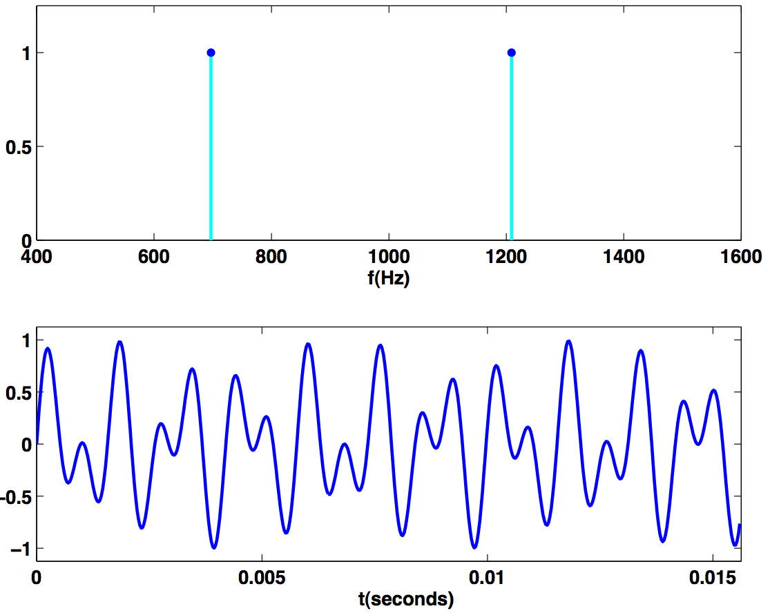
Touch Tone
Button 1 signal. [exact]
Magnitude of Fourier transform of button 1 signal.
Reference: Cleve Moler, Numerical Computing with MATLAB
Notes:
fft is complex number - we plot the magnitude
We assume it's continuous (or many many samples)

Slide 5
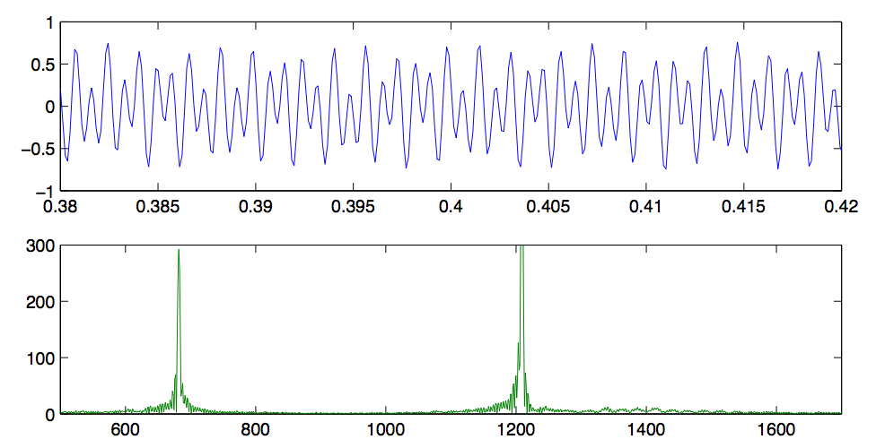
Touch Tone
Button 1 signal. [recorded, 8192 samples per second]
Magnitude of FFT.
Reference: Cleve Moler, Numerical Computing with MATLAB
Notes:
fft is complex number - we plot the magnitude

Slide 6
Fast Fourier Transform: Brief History
Gauss (1805, 1866). Analyzed periodic motion of asteroid Ceres.
Runge-König (1924). Laid theoretical groundwork.
Danielson-Lanczos (1942). Efficient algorithm.
Cooley-Tukey (1965). Monitoring nuclear tests in Soviet Union and tracking submarines. Rediscovered and popularized FFT.
Importance not fully realized until advent of digital computers.
Notes:
Gauss' algorithm published posthumously in 1866

Slide 7
Polynomials: Coefficient Representation
Polynomial. [coefficient representation]
Add: O(n) arithmetic operations.
Evaluate: O(n) using Horner's method.
Multiply (convolve): O(n²) using brute force.
Notes:
can also multiply in O(n^1.585) using Karatsuba polynomial multiplication

Slide 8
Polynomials: Point-Value Representation
Fundamental theorem of algebra. [Gauss, PhD thesis] A degree n polynomial with complex coefficients has n complex roots.
Corollary. A degree n-1 polynomial A(x) is uniquely specified by its evaluation at n distinct values of x.
y
y_{j} = A(x_{j})
x_{j}
x
Notes:
deep theorem - proof requires analysis
conjectures in 17th century, but not rigorously proved until Gauss' phd thesis
established imaginary numbers as fundamental mathematical objects

Slide 9
Polynomials: Point-Value Representation
Polynomial. [point-value representation]
Add: O(n) arithmetic operations.
Multiply: O(n), but need 2n-1 points.
Evaluate: O(n²) using Lagrange's formula.
Notes:
Lagrange's formula is numerically unstable

Slide 10
Converting Between Two Polynomial Representations
Tradeoff. Fast evaluation or fast multiplication. We want both!
Goal. Make all ops fast by efficiently converting between two representations.
Representation
Multiply
Evaluate
Coefficient
O(n²)
O(n)
Point-value
O(n)
O(n²)
coefficient
representation
point-value
representation

Slide 11
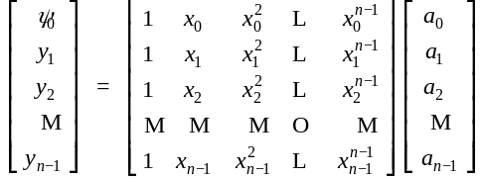
Converting Between Two Polynomial Representations: Brute Force
Coefficient to point-value. Given a polynomial a₀ + a₁ x + ... + a_{n-1} x^{n-1}, evaluate it at n distinct points x₀, ... , x_{n-1}.
Point-value to coefficient. Given n distinct points x₀, ..., x_{n-1} and values y₀, ..., y_{n-1}, find unique polynomial a₀ + a₁ x + ... + a_{n-1} x^{n-1} that has given values at given points.
O(n²) for matrix-vector multiply
O(n³) for Gaussian elimination
Vandermonde matrix is invertible iff x_{i} distinct

Slide 12
Coefficient to Point-Value Representation: Intuition
Coefficient to point-value. Given a polynomial a₀ + a₁ x + ... + a_{n-1} x^{n-1}, evaluate it at n distinct points x₀, ... , x_{n-1}.
Divide. Break polynomial up into even and odd powers.
  A(x) = a₀ + a₁x + a₂x² + a₃x³ + a₄x⁴ + a₅x⁵ + a₆x⁶ + a₇x⁷.
  A_{even}(x) = a₀ + a₂x + a₄x² + a₆x³.
  A_{odd} (x) = a₁ + a₃x + a₅x² + a₇x³.
  A(-x) = A_{even}(x²) + x A_{odd}(x²).
  A(-x) = A_{even}(x²) - x A_{odd}(x²).
Intuition. Choose two points to be ±1.
  A(-1) = A_{even}(1) + 1 A_{odd}(1).
  A(-1) = A_{even}(1) - 1 A_{odd}(1).
Can evaluate polynomial of degree ≤ n
at 2 points by evaluating two polynomials of degree ≤ ½n at 1 point.

Slide 13
Coefficient to Point-Value Representation: Intuition
Coefficient to point-value. Given a polynomial a₀ + a₁ x + ... + a_{n-1} x^{n-1}, evaluate it at n distinct points x₀, ... , x_{n-1}.
Divide. Break polynomial up into even and odd powers.
  A(x) = a₀ + a₁x + a₂x² + a₃x³ + a₄x⁴ + a₅x⁵ + a₆x⁶ + a₇x⁷.
  A_{even}(x) = a₀ + a₂x + a₄x² + a₆x³.
  A_{odd} (x) = a₁ + a₃x + a₅x² + a₇x³.
  A(-x) = A_{even}(x²) + x A_{odd}(x²).
  A(-x) = A_{even}(x²) - x A_{odd}(x²).
Intuition. Choose four points to be ±1, ±i.
  A(-1) = A_{even}(-1) + 1 A_{odd}( 1).
  A(-1) = A_{even}(-1) - 1 A_{odd}(-1).
  A(-i) = A_{even}(-1) + i A_{odd}(-1).
  A(-i) = A_{even}(-1) - i A_{odd}(-1).
Can evaluate polynomial of degree ≤ n
at 4 points by evaluating two polynomials of degree ≤ ½n at 2 points.

Slide 14
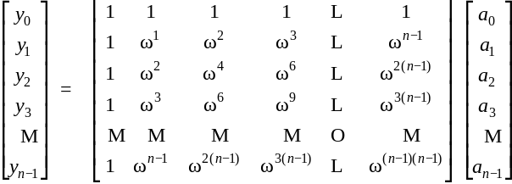
Discrete Fourier Transform
Coefficient to point-value. Given a polynomial a₀ + a₁ x + ... + a_{n-1} x^{n-1}, evaluate it at n distinct points x₀, ... , x_{n-1}.
Key idea: choose x_{k} = ω^{k} where ω is principal n^{th} root of unity.
Discrete Fourier transform
Fourier matrix F_{n}

Slide 15
Roots of Unity
Def. An n^{th} root of unity is a complex number x such that x^{n} = 1.
Fact. The n^{th} roots of unity are: ω⁰, ω¹, …, ω^{n-1} where ω = e ^{2π i / n}.
Pf. (ω^{k})^{n} = (e ^{2π i k / n}) ^{n} = (e ^{π i} ) ^{2k} = (-1) ^{2k} = 1.
Fact. The ½n^{th} roots of unity are: ν⁰, ν¹, …, ν^{n/2-1} where ν = e ^{4π i / n}.
Fact. ω² = ν and (ω²)^{k} = ν^{k}.
ω² = ν¹ = i
ω³
ω¹
ω⁴ = ν² = -1
n = 8
ω⁰ = ν⁰ = 1
ω⁵
ω⁷
ω⁶ = ν³ = -i
Notes:
forms a group under multiplication (similar to additive group Z_n modulo n)

Slide 16
Fast Fourier Transform
Goal. Evaluate a degree n-1 polynomial A(x) = a₀ + ... + a_{n-1} x^{n-1} at its n^{th} roots of unity: ω⁰, ω¹, …, ω^{n-1}.
Divide. Break polynomial up into even and odd powers.
  A_{even}(x) = a₀ + a₂x + a₄x² + … + a_{n/2-2} x^{(n-1)/2}.
  A_{odd} (x) = a₁ + a₃x + a₅x² + … + a_{n/2-1} x^{(n-1)/2}.
  A(x) = A_{even}(x²) + x A_{odd}(x²).
Conquer. Evaluate degree A_{even}(x) and A_{odd}(x) at the ½n^{th} roots of unity: ν⁰, ν¹, …, ν^{n/2-1}.
Combine.
  A(ω^{k+n}) = A_{even}(ν^{k}) + ω^{k} A_{odd}(ν^{k}), 0 ≤ k < n/2
  A(ω^{k+n}) = A_{even}(ν^{k}) - ω^{k} A_{odd}(ν^{k}), 0 ≤ k < n/2
ν^{k} = (ω^{k})² = (ω^{k+ ½n})²
ω^{k+½n} = -ω^{k}

Slide 17
FFT Algorithm
fft(n, a₀,a₁,…,a_{n-1}) {
if (n == 1) return a₀
(e₀,e₁,…,e_{n/2-1}) ← FFT(n/2, a₀,a₂,a₄,…,a_{n-2})
(d₀,d₁,…,d_{n/2-1}) ← FFT(n/2, a₁,a₃,a₅,…,a_{n-1})
for k = 0 to n/2 - 1 {
ω^{k} ← e^{2πik/n}
y_{k+n/2} ← e_{k} + ω^{k} d_{k}
y_{k+n/2} ← e_{k} - ω^{k} d_{k}
}
return (y₀,y₁,…,y_{n-1})
}

Slide 18

FFT Summary
Theorem. FFT algorithm evaluates a degree n-1 polynomial at each of the n^{th} roots of unity in O(n log n) steps.
Running time. T(2n) = 2T(n) + O(n) ⇒ T(n) = O(n log n).
assumes n is a power of 2
O(n log n)
coefficient
representation
point-value
representation

Slide 19
Recursion Tree
a₀, a₁, a₂, a₃, a₄, a₅, a₆, a₇
perfect shuffle
a₀, a₂, a₄, a₆
a₁, a₃, a₅, a₇
a₀, a₄
a₂, a₆
a₁, a₅
a₃, a₇
a₀
a₄
a₂
a₆
a₁
a₅
a₃
a₇
000
100
010
110
001
101
011
111
"bit-reversed" order
Notes:
each recursive call performs a "perfect shuffle"
leaves of tree are in "bit-reversed" order - if you read the bits backwards, it counts from 000 to 111 in binary

Slide 20
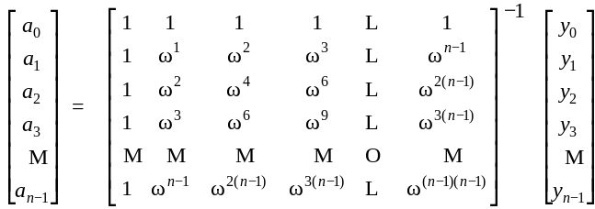
Point-Value to Coefficient Representation: Inverse DFT
Goal. Given the values y₀, ... , y_{n-1} of a degree n-1 polynomial at the n points ω⁰, ω¹, …, ω^{n-1}, find unique polynomial a₀ + a₁ x + ... + a_{n-1} x^{n-1} that has given values at given points.
Inverse DFT
Fourier matrix inverse (F_{n})⁻¹

Slide 21
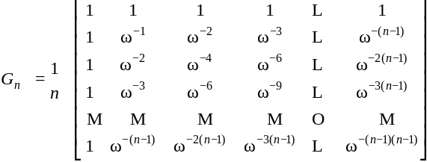
Inverse FFT
Claim. Inverse of Fourier matrix is given by following formula.
Consequence. To compute inverse FFT, apply same algorithm but use
ω⁻¹ = e ^{-2π i / n} as principal n^{th} root of unity (and divide by n).

Slide 22


Inverse FFT: Proof of Correctness
Claim. F_{n} and G_{n} are inverses.
Pf.
Summation lemma. Let ω be a principal n^{th} root of unity. Then
Pf.
  If k is a multiple of n then ω^{k} = 1 ⇒ sums to n.
  Each n^{th} root of unity ω^{k} is a root of x^{n} - 1 = (x - 1) (1 + x + x² + ... + x^{n-1}).
  if ω^{k} ≠ 1 we have: 1 + ω^{k} + ω^{k(2)} + . . . + ω^{k(n-1)} = 0 ⇒ sums to 0. ▪
summation lemma

Slide 23
Inverse FFT: Algorithm
ifft(n, a₀,a₁,…,a_{n-1}) {
if (n == 1) return a₀
(e₀,e₁,…,e_{n/2-1}) ← FFT(n/2, a₀,a₂,a₄,…,a_{n-2})
(d₀,d₁,…,d_{n/2-1}) ← FFT(n/2, a₁,a₃,a₅,…,a_{n-1})
for k = 0 to n/2 - 1 {
ω^{k} ← e^{-2πik/n}
y_{k+n/2} ← (e_{k} + ω^{k} d_{k}) / n
y_{k+n/2} ← (e_{k} - ω^{k} d_{k}) / n
}
return (y₀,y₁,…,y_{n-1})
}

Slide 24
Inverse FFT Summary
Theorem. Inverse FFT algorithm interpolates a degree n-1 polynomial given values at each of the n^{th} roots of unity in O(n log n) steps.
assumes n is a power of 2
O(n log n)
coefficient
representation
O(n log n)
point-value
representation

Slide 25


Polynomial Multiplication
Theorem. Can multiply two degree n-1 polynomials in O(n log n) steps.
coefficient
representation
coefficient
representation
FFT
O(n log n)
inverse FFT
O(n log n)
point-value multiplication
O(n)

Slide 26
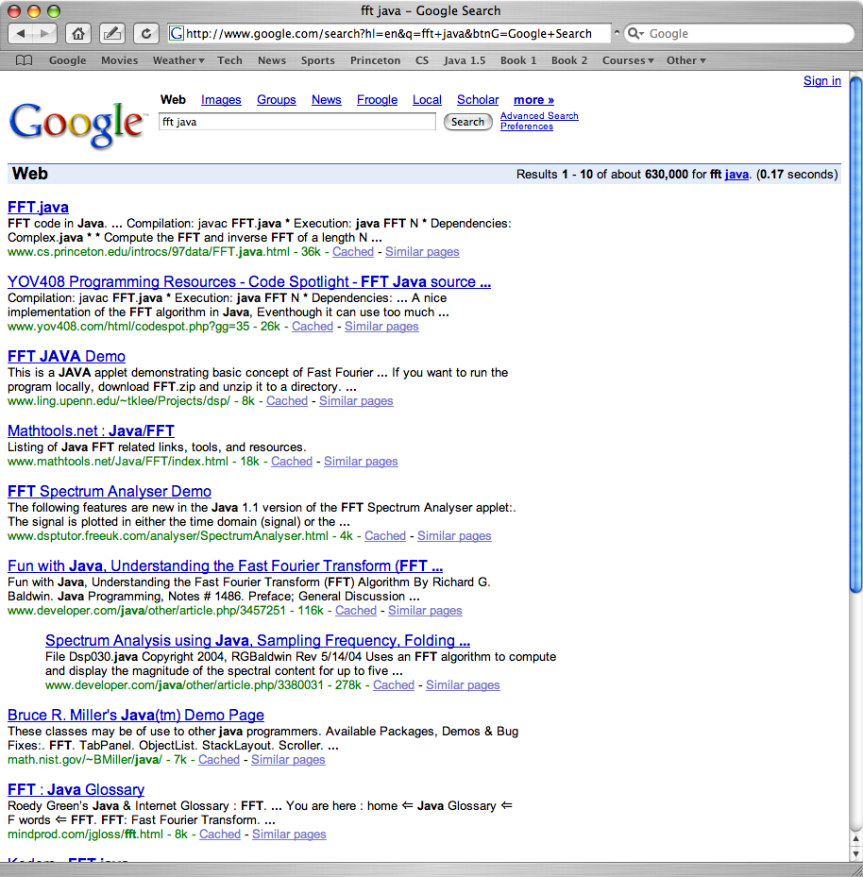
FFT in Practice ?

Slide 27
FFT in Practice
Fastest Fourier transform in the West. [Frigo and Johnson]
  Optimized C library.
  Features: DFT, DCT, real, complex, any size, any dimension.
  Won 1999 Wilkinson Prize for Numerical Software.
  Portable, competitive with vendor-tuned code.
Implementation details.
  Instead of executing predetermined algorithm, it evaluates your hardware and uses a special-purpose compiler to generate an optimized algorithm catered to "shape" of the problem.
  Core algorithm is nonrecursive version of Cooley-Tukey radix 2 FFT.
  O(n log n), even for prime sizes.
Reference: http://www.fftw.org

Slide 28
Integer Multiplication
Integer multiplication. Given two n bit integers a = a_{n-1} … a₁a₀ and
b = b_{n-1} … b₁b₀, compute their product c = a × b.
Convolution algorithm.
  Form two polynomials.
  Note: a = A(2), b = B(2).
  Compute C(x) = A(x) × B(x).
  Evaluate C(2) = a × b.
  Running time: O(n log n) complex arithmetic operations.
Theory. [Schönhage-Strassen 1971] O(n log n log log n) bit operations.
Theory. [Fürer 2007] O(n log n 2^{O(log *n)}) bit operations.
Practice. [GNU Multiple Precision Arithmetic Library] GMP proclaims to be "the fastest bignum library on the planet." It uses brute force, Karatsuba, and FFT, depending on the size of n.

Slide 29
Extra Slides

Slide 30
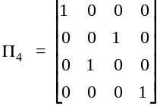
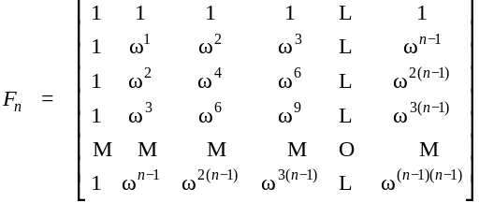
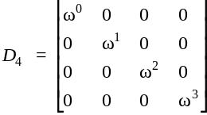

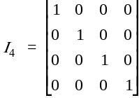

Fourier Matrix Decomposition
Fourier matrix decomposition.

